Slide 1
Molecular Genetics
Lecture - 1
Rupak Datta
Office TRC (second floor) # 223
Email: rupakdatta@iiserkol.ac.in
Co-instructor:
Dr. Malancha Ta
Email: malancha.ta@iiserkol.ac.in
Teaching Assistants: Shahana Shirin (ss19ms049@iiserkol.ac.in); Purba Bera (pb23rs009@iiserkol.ac.in)
Sristhi Dutta Gupta (sdg19rs080@iiserkol.ac.in); Nitish Pal (np18ms191@iiserkol.ac.in)

Slide 2
Syllabus and mode of evaluation
Rupak Datta
DNA structure and organization
RNA & non-coding RNAs
Basics of replication, transcription and translation.
DNA recombination and repair.
Malancha Ta
Bacterial genetics - Mutations, Transformation, Conjugation, Transduction
Basics of Lac operon.
Phages - Small SS-DNA phages, Alpha phage, P1 phage.
Gene manipulation and recombinant DNA technology.
Internal assessment
To be done through class tests and assignment etc.

Slide 3
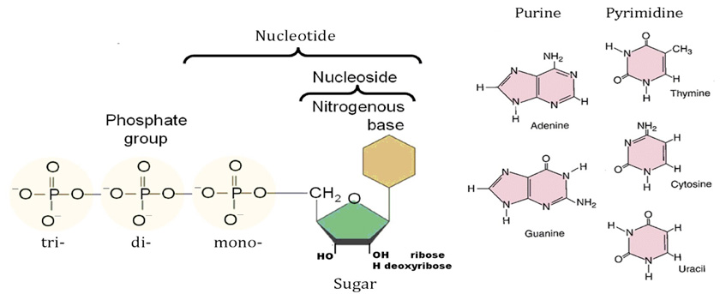
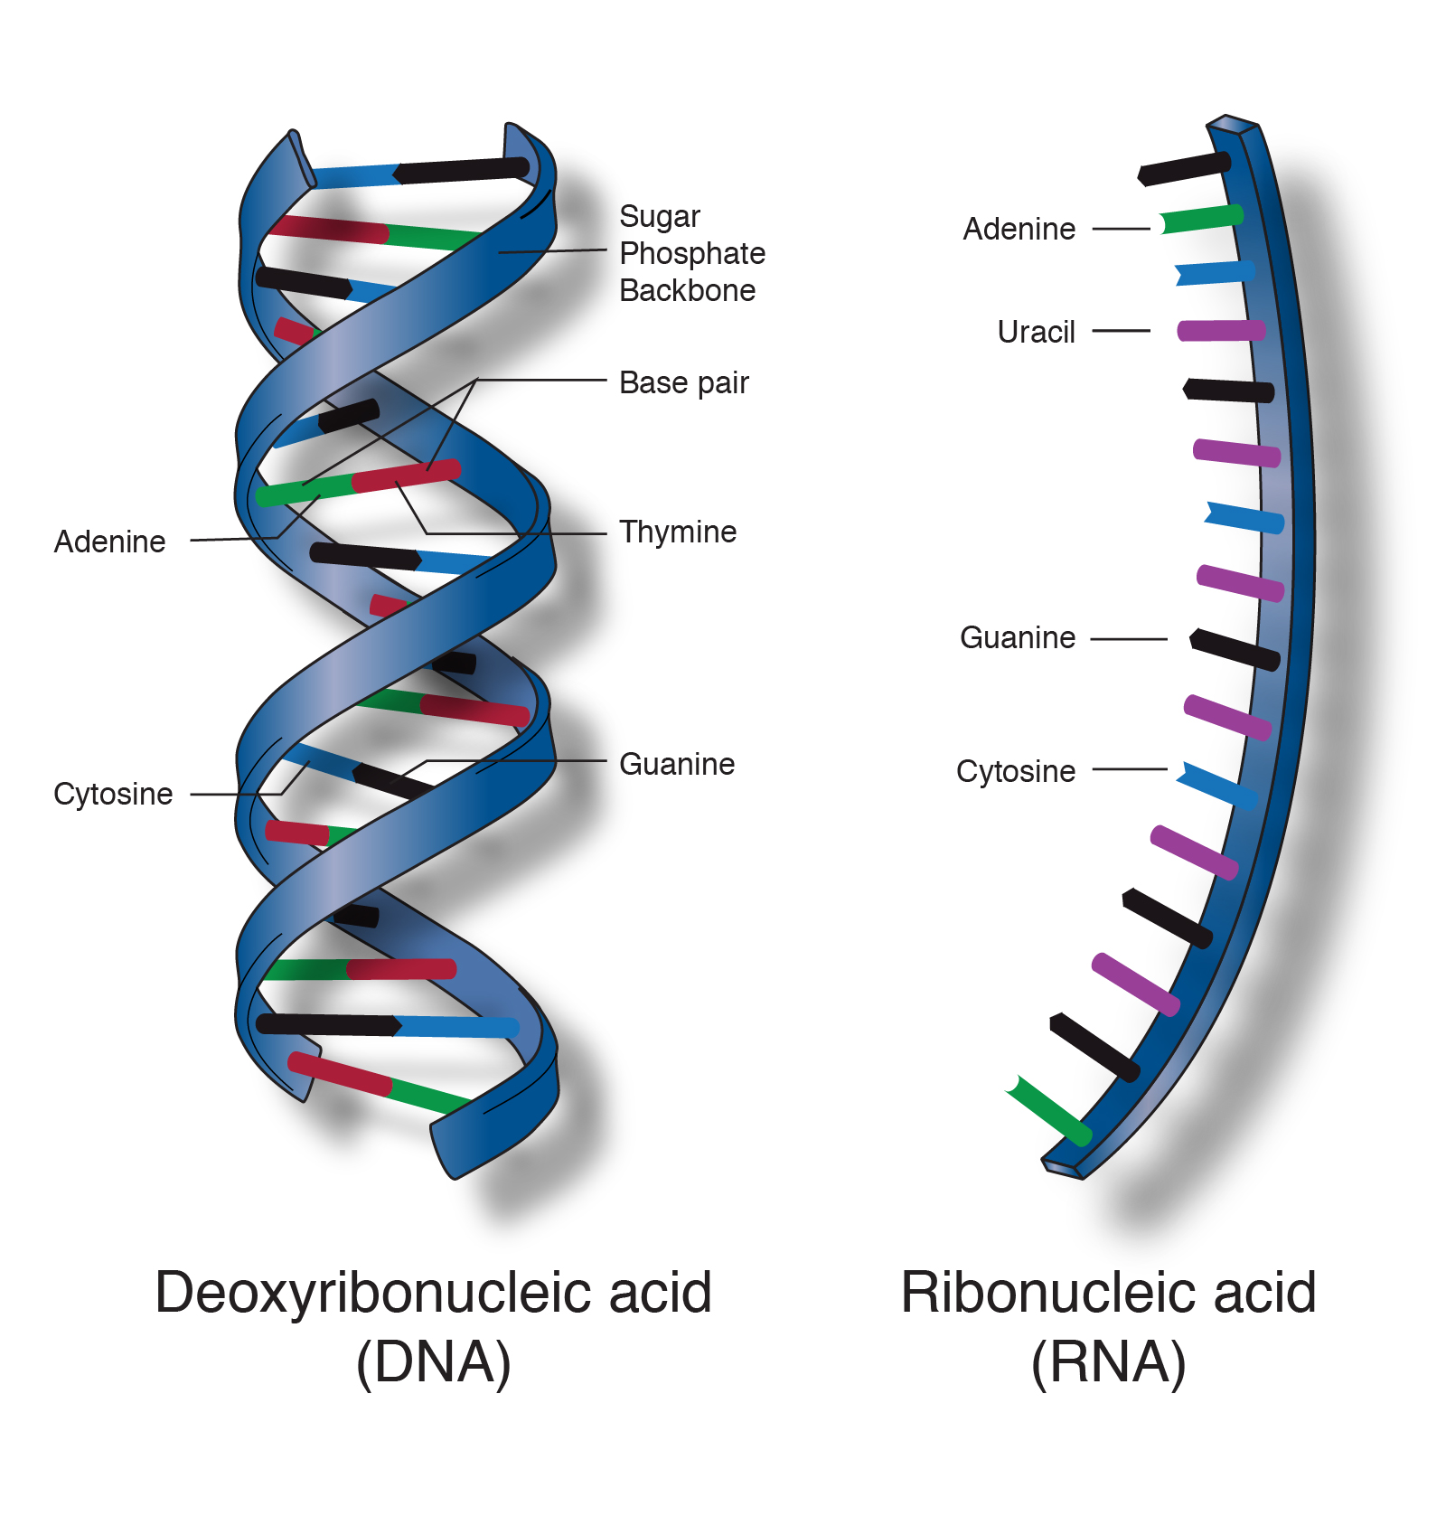

Slide 4
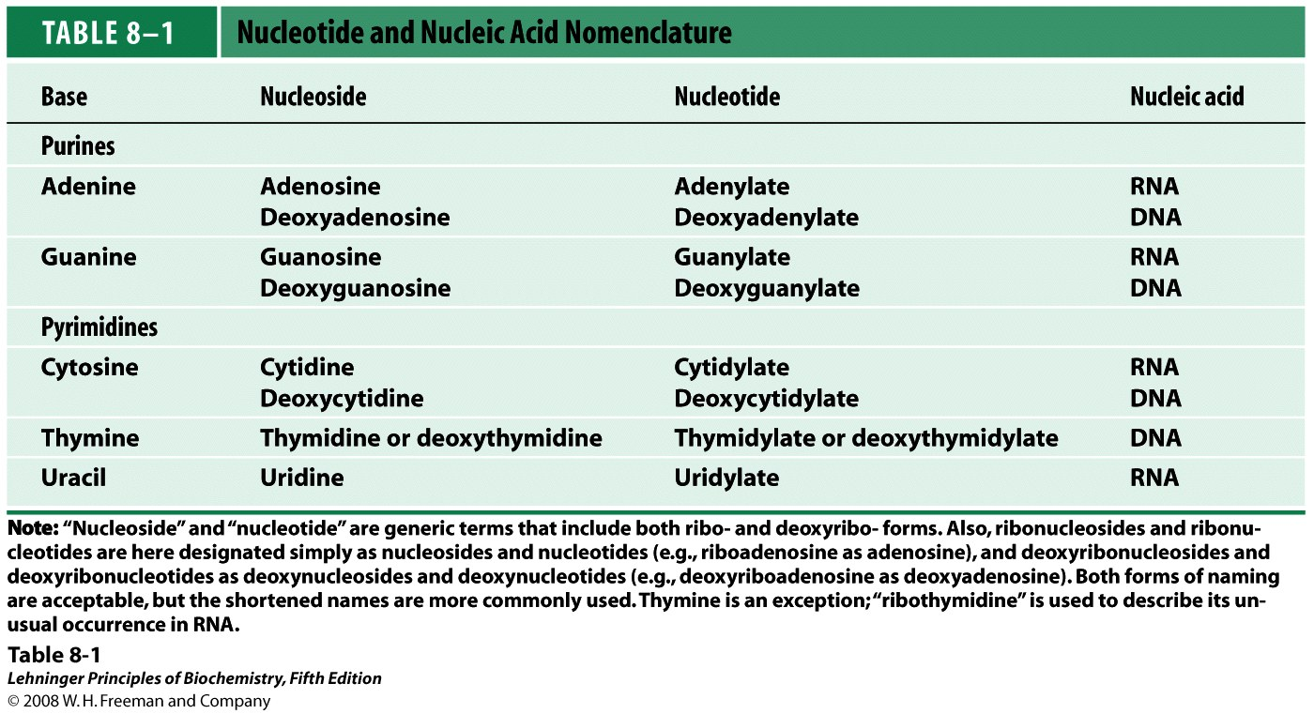
Notes:
Nucleotides have three characteristic components:
(1) a nitrogenous (nitrogen-containing) base, (2) a pentose,
and (3) a phosphate (Fig. 8–1). The molecule without
the phosphate group is called a nucleoside. The
nitrogenous bases are derivatives of two parent compounds,
pyrimidine and purine.

Slide 5
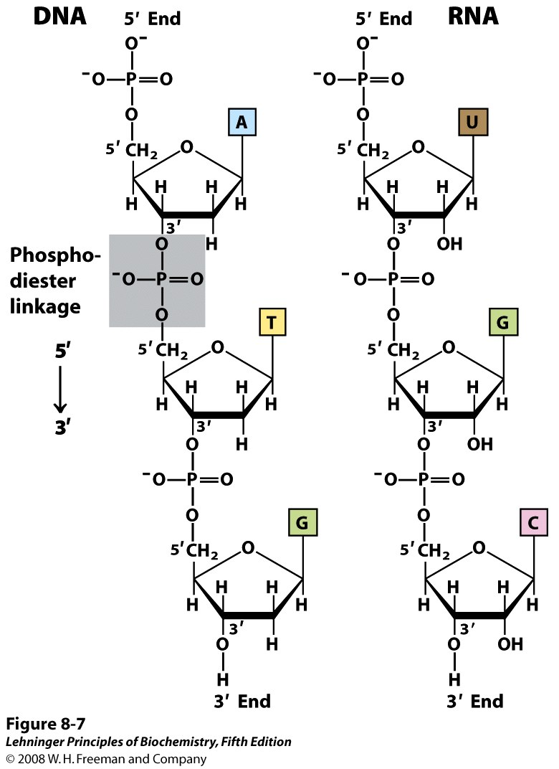
Phosphodiester linkage

Slide 6
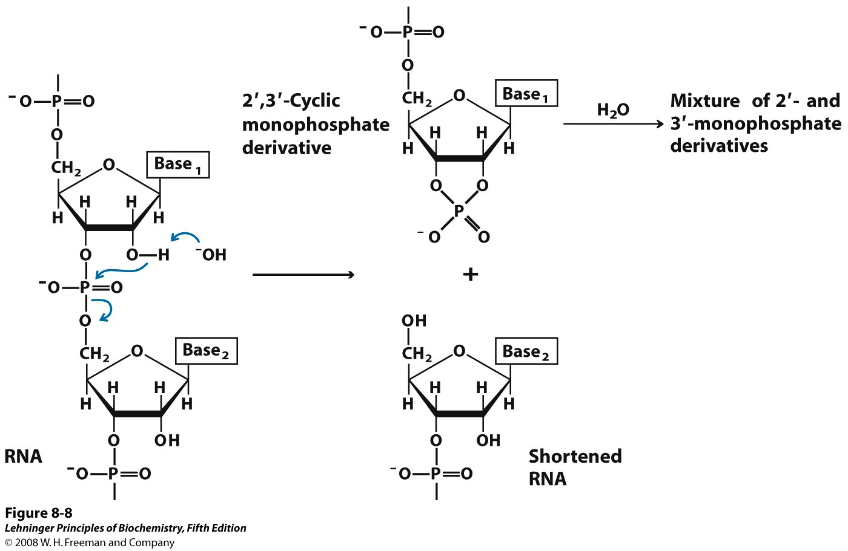
Alkaline hydrolysis of RNA
Notes:
RNA hydrolysis occurs when the deprotonated 2’ OH of the ribose, acting as a nucleophile, attacks the adjacent phosphorus in the phosphodiester bond of the sugar-phosphate backbone of the RNA.^{[1]} There is a transition state (shown above), where the phosphorus is bonded to five oxygen atoms.^{[2]} The phosphorus then detaches from the oxygen connecting it to the adjacent sugar, resulting in ester cleavage of the RNA backbone. (This mechanism is also referred to as RNA cleavage.) This produces a 2’,3’-cyclic phosphate that can then yield either a 2’- or a 3’-nucleotide when hydrolyzed. This process is shown in Figure 1.^{[1]}

Slide 7
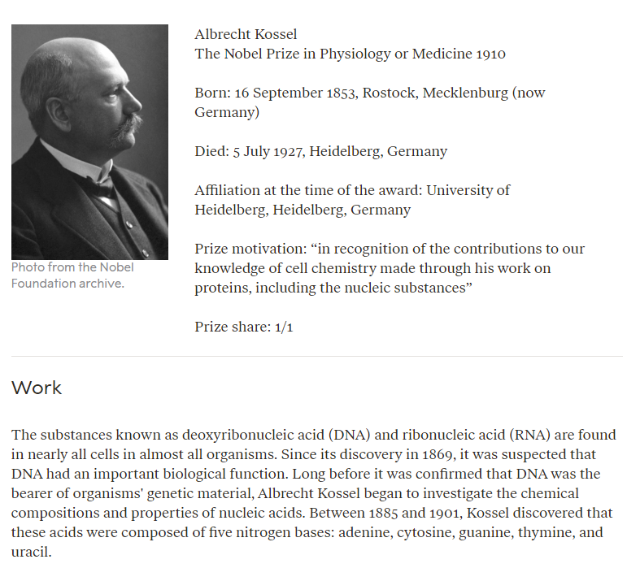

Slide 8
DNA as genetic material
Griffith’s experiment (1928) - "transforming principle" in pneumococcus bacteria
Avery–MacLeod–McCarty experiment (1944) – Identified DNA as the substance causing bacterial transformation
Hershey-Chase experiment (1952) – Confirmed DNA as a genetic material of virus

Slide 9
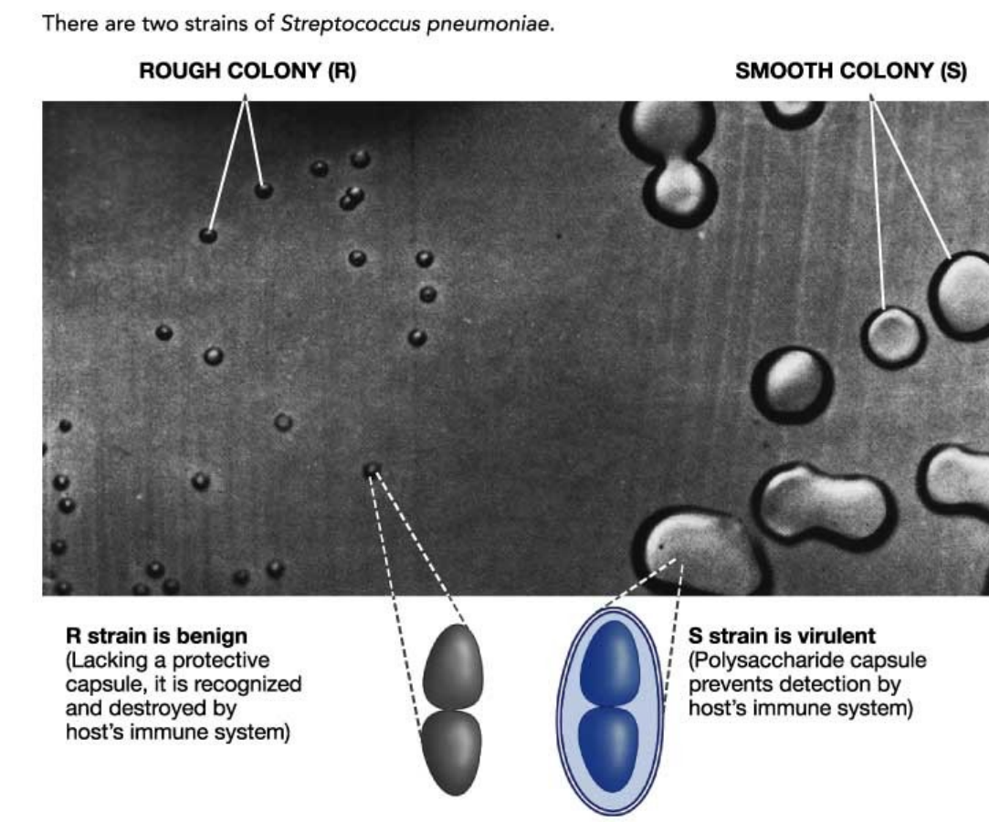
Notes:
Streptococcus pneumoniae, or pneumococcus, is a Gram-positive, spherical bacteria. Streptococcus pneumoniae resides asymptomatically in healthy carriers typically colonizing the respiratory tract, sinuses, and nasal cavity.

Slide 10
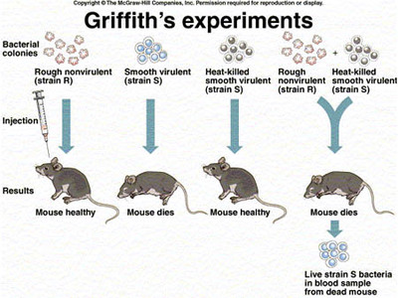
"transforming principle" in pneumococcus bacteria (1928)

Slide 12
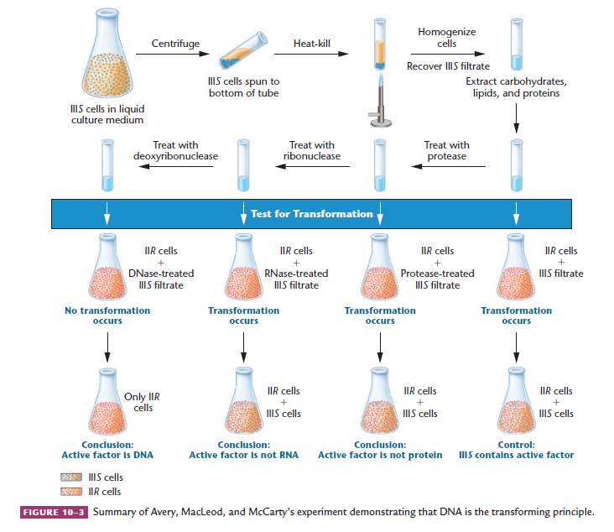
Klug & cummings(10th edition)

Slide 13
(1952)
Notes:
Alfred Hershey and Martha Chase

Slide 14
